Slide 1
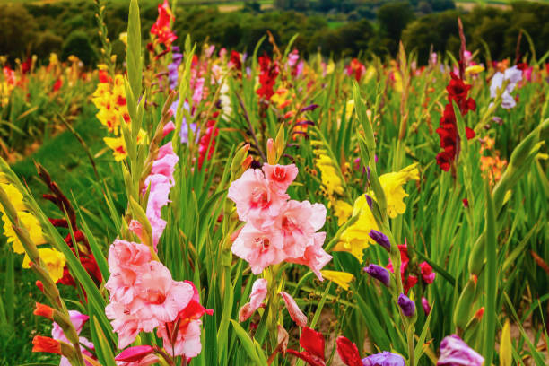
A Service of
Holy Eucharist,
Book of Alternative Services
August 16, 2026
WELCOME!
Prelude
a time of quiet preparation

Slide 2
Opening Hymn
Let Us Build a House
1. Let us built a house where love can dwell
and all can safely live,
A place where saints and children tell
how hearts learn to forgive.
Built of hopes and dreams and visions,
rock of faith and vault of grace;

Slide 3
Opening Hymn
Let Us Build a House
Here the love of Christ shall end divisions:
All are welcome, all are welcome,
all are welcome in this place.

Slide 4
Opening Hymn
Let Us Build a House
2.Let us build a house where prophets speak
and words are strong and true,
Where all God’s children dare to seek
to dream God’s reign anew.
Here the cross shall stand as witness
and as the symbol of God’s grace;

Slide 5
Opening Hymn
Let Us Build a House
Here as one we claim the faith of Jesus:
All are welcome, all are welcome,
all are welcome in this place.

Slide 6
Opening Hymn
Let Us Build a House
3. Let us build a house where love is found
in water, wine and wheat;
A banquet hall on holy ground,
where peace and justice meet.
Here the love of God, through Jesus,
is revealed in time and space;

Slide 7
Opening Hymn
Let Us Build a House
As we share in Christ the feast that frees us:
All are welcome, all are welcome,
all are welcome in this place.

Slide 8
Opening Hymn
Let Us Build a House
4. Let us build a house where hands will reach beyond the wood and stone.
To heal and strengthen, serve and teach,
and live the Word they’ve known,
Here the outcast and the stranger
bear the image of God’s face;

Slide 9
Opening Hymn
Let Us Build a House
Let us bring an end to fear and danger:
All are welcome, all are welcome,
all are welcome in this place.

Slide 10
Opening Hymn
Let Us Build a House
5. Let us build a house where all are named,
their songs and visions heard
And loved and treasured, taught and claimed
as words within the Word.
Built of tears and cries and laughter,
prayers of faith and songs of grace,

Slide 11
Opening Hymn
Let Us Build a House
Let this house proclaim from floor to rafter:
All are welcome, all are welcome,
all are welcome in this place.

Slide 12

Land Acknowledgement
We acknowledge that this church is situated on the traditional territory of the Mississauga peoples and is covered by the Williams Treaties. We recognize the enduring presence of Indigenous peoples connected to and on this land. We are grateful for the opportunity to gather on this territory, and we commit ourselves to the work of reconciliation with First Nations, Inuit and Métis peoples.
Creator, let us be of Good Mind to reconcile ourselves, and to work for justice and reconciliation with the peoples and the land. With thankful and respectful hearts, we pray in Your name, Your Son the Peacemaker and the Sacred Spirit. Amen.

Slide 13
Opening Sentence
Celebrant Jesus preached the gospel of the kingdom and healed every infirmity among the people.
See Matthew 4.23

Slide 14
Gathering of the Community
Celebrant The grace of our Lord Jesus Christ, and the love of God, and the fellowship of the Holy Spirit, be with you all.
People And also with you.

Slide 15
Gathering of the Community
Celebrant Almighty God,
All to you all hearts are open, all desires known, and from you no secrets are hidden. Cleanse the thoughts of our hearts by the inspiration of your Holy Spirit, that we may perfectly love you, and worthily magnify your holy name; through Christ our Lord. Amen.

Slide 16
Gloria
Celebrant Glory to God in the highest
All and peace to his people on earth.
Lord God, heavenly king, almighty God and Father, we worship you, we give you thanks, we praise you for your glory. Lord Jesus Christ, only Son of the Father, Lord God, Lamb of God, you take away the sin of the world: have mercy on us;

Slide 17
Gloria
you are seated at the right hand of the Father: receive our prayer. For you alone are the Holy One, you alone are the Lord, you alone are the Most High, Jesus Christ, with the Holy Spirit, in the glory of God the Father. Amen.

Slide 18
The Collect of the Day
Celebrant: Let us pray
All: Almighty God, you have broken the tyranny of sin
and sent into our hearts the Spirit of your Son. Give us grace to dedicate our freedom to your service, that all people may know the glorious liberty of the children of God; through Jesus Christ our Lord, who lives and reigns with you and the Holy Spirit, one God, now and for ever. Amen

Slide 19
Collect for 190th Anniversary
Celebrant: O Gracious God of blessing, we give you thanks and praise for our beloved parish, St. Paul's. We especially give thanks for 190 years of ministry, faithfully serving our neighbours and upholding each other as a community of believers. We ask you now to grant us many more years of ministry, worship and fellowship in this place. Send your Holy Spirit to guide and direct us, renewing our faith and helping us to proclaim the Good News of your Son, our Saviour, Jesus Christ, in both our words and our actions. Amen.

Slide 20
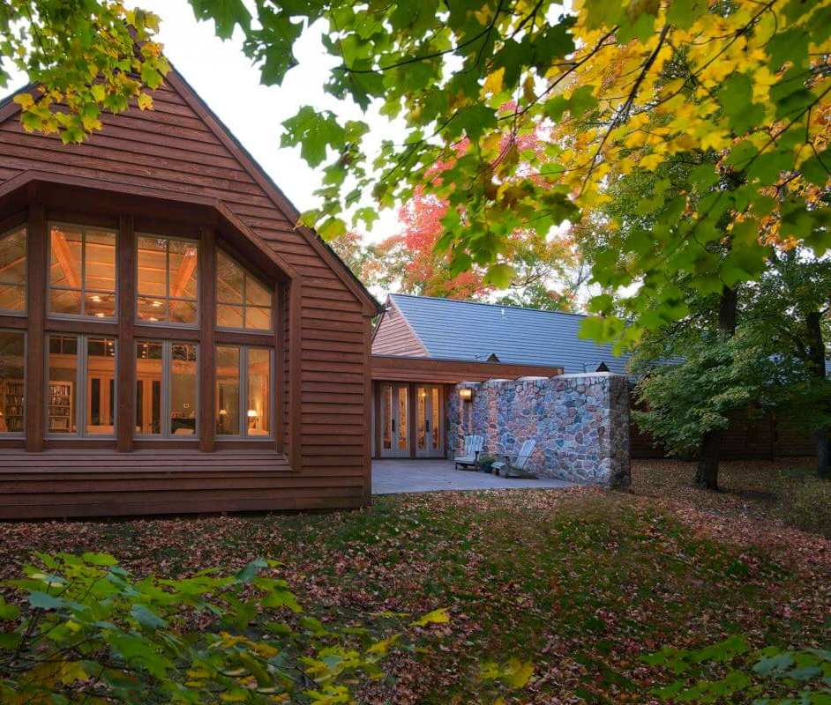
The Proclamation of the Word
Isaiah
56:1, 6-8
Photo credit: Dana Wheelock, Episcopal House of Prayer, Collegeville, MN

Slide 21
Psalm 67 (responsively)
1 May God be merciful to us and bless us,
show us the light of his countenance and come to us.
2 Let your ways be known upon earth, your saving health among all nations.
3 Let the peoples praise you, O God; let all the peoples praise you.

Slide 22
Psalm 67 (responsively)
4 Let the nations be glad and sing for joy, for you judge the peoples with equity and guide all the nations upon earth.
5 Let the peoples praise you, O God;
let all the peoples praise you.

Slide 23
Psalm 67 (responsively)
6 The earth has brought forth her increase; may God, our own God, give us his blessing.
7 May God give us his blessing and may all the ends of the earth stand in awe of him.

Slide 24
Psalm 119:129-136 (responsively)
All Blessed are you, Lord our God, light of the earth and health of the nations; you lead us in the way of justice and mercy, through Jesus Christ our Lord. Amen.

Slide 25
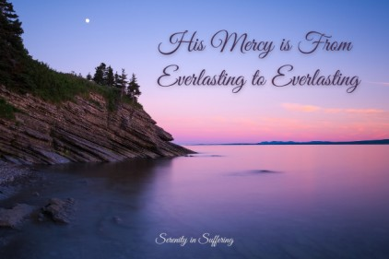
The Proclamation of the Word
Romans
11:1-2a, 29-32

Slide 26
Gradual Hymn:
#292 We Cannot Measure How You Heal vs 1,2
1. We cannot measure how you heal
or answer every sufferer's prayer,
yet we believe your grace responds
where faith and doubt unite to care.

Slide 27
Gradual Hymn:
#292 We Cannot Measure How You Heal vs 1,2
Your hands, though bloodied on the cross,
survive to hold and heal and warn,
to carry all through death to life
and cradle children yet unborn.

Slide 28
Gradual Hymn:
#292 We Cannot Measure How You Heal vs 1,2
2. The pain that will not go away,
the guilt that clings from things long past,
the fear of what the future holds,
are present as if meant to last.

Slide 29
Gradual Hymn:
#292 We Cannot Measure How You Heal vs 1,2
But present too is love which tends
the hurt we never hope to find,
the private agonies inside,
the memories that haunt the mind.

Slide 30
Gospel Response
Celebrant The Lord be with you.
People And also with you.
Celebrant The Holy Gospel of our Lord Jesus Christ
according to Matthew
People Glory to you, Lord Jesus Christ.

Slide 31
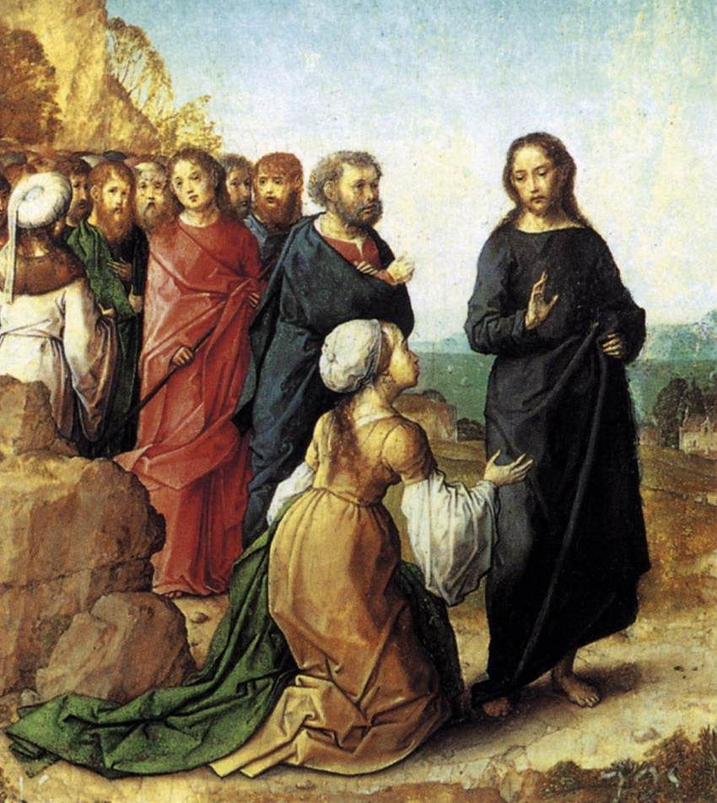
Gospel
–
Matthew
15:21-28
The Canaanite Woman asks for healing for her daughter, Juan de Flandes ca. 1500

Slide 32
Gospel Response
Celebrant The Gospel of Christ.
People Praise to you, Lord Jesus Christ.

Slide 33
Gradual Hymn:
#292 We Cannot Measure How You Heal v. 3
3. So some have come who need your help
and some have come to make amends,
as hands which shaped and saved the world
are present in the touch of friends.

Slide 34
Gradual Hymn:
#292 We Cannot Measure How You Heal vs 1,2
Lord, let your Spirit meet us here
to mend the body, mind, and soul,
to disentangle peace from pain
and make your broken people whole.

Slide 35
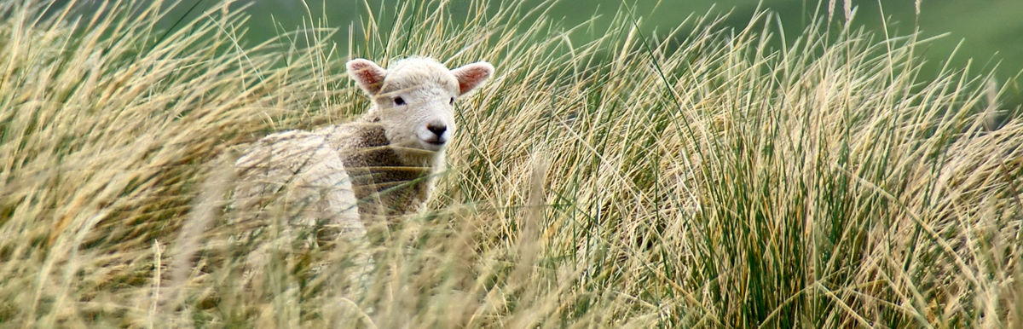
Homily

Slide 36
The Apostles’ Creed
Celebrant Let us confess the faith of our baptism as we say,
All I believe in God, the Father almighty, creator of heaven and earth. I believe in Jesus Christ, his only Son, our Lord. He was conceived by the power of the Holy Spirit and born of the Virgin Mary. He suffered under Pontius Pilate, was crucified, died, and was buried. He descended to the dead. On the third day he rose again.

Slide 37
The Apostles’ Creed
All He ascended into heaven, and is seated at the right hand of the Father. He will come again to judge the living and the dead. I believe in the Holy Spirit, the holy catholic Church, the communion of saints, the forgiveness of sins, the resurrection of the body, and the life everlasting. Amen.

Slide 38
The Prayers of the People – Litany # 7
(Let us pray in faith to God our Father, to his Son Jesus Christ, and to the Holy Spirit, saying, “Lord, hear and have mercy.”)
For the Church of the living God throughout the world, let us ask the riches of his grace.
Lord, hear and have mercy.

Slide 39
The Prayers of the People – Litany # 7
For all who proclaim the word of truth, let us ask the infinite wisdom of Christ.
Lord, hear and have mercy.
For all who have consecrated their lives to the kingdom of God, and for all struggling to follow the way of Christ, let us ask the gifts of the Spirit.
Lord, hear and have mercy.

Slide 40
The Prayers of the People – Litany # 7
For Charles our King, for the Prime Minister of this country, and for all who govern the nations, that they may strive for justice and peace, let us ask the strength of God.
Lord, hear and have mercy.
For scholars and research-workers, that their studies may benefit humanity, let us ask the light of the Lord.
Lord, hear and have mercy.

Slide 41
The Prayers of the People – Litany # 7
For all who have passed from this life in faith and obedience, let us ask the peace of Christ.
Lord, hear and have mercy. Amen

Slide 42
Confession and Absolution
Celebrant Dear friends in Christ, God is steadfast in love and infinite in mercy; he welcomes sinners and invites them to his table. Let us confess our sins, confident in God’s forgiveness.
Silence is kept.
Celebrant Most merciful God,

Slide 43
Confession and Absolution
All we confess that we have sinned against you in thought, word, and deed, by what we have done, and by what we have left undone. We have not loved you with our whole heart; we have not loved our neighbours as ourselves. We are truly sorry and we humbly repent. For the sake of your Son Jesus Christ, have mercy on us and forgive us, that we may delight in your will, and walk in your ways, to the glory of your name. Amen.

Slide 44
Confession and Absolution
Celebrant Almighty God have mercy upon you, pardon and deliver you from all your sins, confirm and strengthen you in all goodness, and keep you in eternal life; through Jesus Christ our Lord. Amen.

Slide 45

We Share the Peace
Celebrant The peace of the Lord be always with you.
People And also with you.
Let’s greet one another with a sign of peace

Slide 46
Offertory Hymn
#435 Take My Life 1, 2, 4 & 5
1. Take my life, and let it
consecrated, Lord, to thee;
take my moments and my days,
let them flow in ceaseless praise.

Slide 47
Offertory Hymn
#435 Take My Life 1, 2, 4 & 5
2. Take my hands, and let them move
at the impulse of thy love;
take my feet, and let them
be swift and purposeful for thee.

Slide 48
Offertory Hymn
#435 Take My Life 1, 2, 4 & 5
4. Take my will, and make it thine;
it shall be no longer mine;
take my heart, it is thine own;
it shall be thy royal throne.

Slide 49
Offertory Hymn
#435 Take My Life 1, 2, 4 & 5
5. Take my love: my Lord, I pour
at thy feet its treasure store;
take myself, and I will be
ever, only, all for thee

Slide 50
Prayer over the Gifts
Celebrant Loving God and Father, you have adopted us to be your heirs. Accept all we offer you this day and give us grace to live as faithful children.
We ask this in the name of Jesus Christ our Lord. Amen.

Slide 51
Eucharistic Prayer - # 2
Celebrant The Lord be with you.
People And also with you.
Celebrant Lift up your hearts.
People We lift them to the Lord.
Celebrant Let us give thanks to the Lord our God.
People It is right to give our thanks and praise.

Slide 52
Eucharistic Prayer - #2
Celebrant We give you thanks and praise, almighty God, through your beloved Son, Jesus Christ, our Saviour and Redeemer. He is your living Word, through whom you have created all things.
By the power of the Holy Spirit he took flesh of the Virgin Mary and shared our human nature. He lived and died as one of us, to reconcile us to you, the God and Father of all.

Slide 53
Eucharistic Prayer - #2
Celebrant In fulfilment of your will he stretched out his hands in suffering, to bring release to those who place their hope in you; and so he won for you a holy people.
He chose to bear our griefs and sorrows, and to give up his life on the cross, that he might shatter the chains of evil and death, and banish the darkness of sin and despair. By his resurrection he brings us into the light of your presence. Now with all creation we raise our voices to proclaim the glory of your name.

Slide 54
Eucharistic Prayer - #2
All Holy, holy, holy Lord, God of power and might, Holy, holy, holy Lord, God of power and might. Heaven and earth are full, full of your glory. Hosanna in the highest, Hosanna in the highest. Blessed is he who comes in the name of the Lord. Hosanna in the highest, Hosanna in the highest.

Slide 55
Eucharistic Prayer - #2
Celebrant Holy and gracious God, accept our praise, through your Son our Saviour Jesus Christ; who on the night he was handed over to suffering and death, took bread and gave you thanks, saying, “Take, and eat: this is my body which is broken for you.” In the same way he took the cup, saying,
“This is my blood which is shed for you. When you do this, you do it in memory of me.”

Slide 56
Eucharistic Prayer - #2
Celebrant Remembering, therefore, his death and resurrection, we offer you this bread and this cup, giving thanks that you have made us worthy to stand in your presence and serve you. We ask you to send your Holy Spirit upon the offering of your holy Church. Gather into one all who share in these sacred mysteries,

Slide 57
Eucharistic Prayer - #2
Celebrant filling them with the Holy Spirit and confirming their faith in the truth, that together we may praise you and give you glory through your Servant, Jesus Christ.
All glory and honour are yours, Father and Son, with the Holy Spirit in the holy Church, now and for ever. Amen.

Slide 58
The Lord’s Prayer
Celebrant And now, as our Saviour Christ has taught us, we are bold to say,
All Our Father, who art in heaven, hallowed be thy name, thy kingdom come, thy will be done, on earth as it is in heaven. Give us this day our daily bread. And forgive us our trespasses, as we forgive those who trespass against us. And lead us not into temptation, but deliver us from evil. For thine is the kingdom, the power, and the glory, for ever and ever. Amen.

Slide 59
The Breaking of the Bread
Celebrant “I am the bread of life,” says the Lord. “Whoever comes to me will never be hungry; whoever believes in me will never thirst.”
All Taste and see that the Lord is good; happy are they who trust in him!

Slide 60
Agnus Dei – #747 Jesus, Lamb of God
All Jesus, Lamb of God, have mercy on us.
Jesus, bearer of our sins, have mercy on us.
Jesus, redeemer, redeemer of the world,
give us your peace, give us your peace.

Slide 61
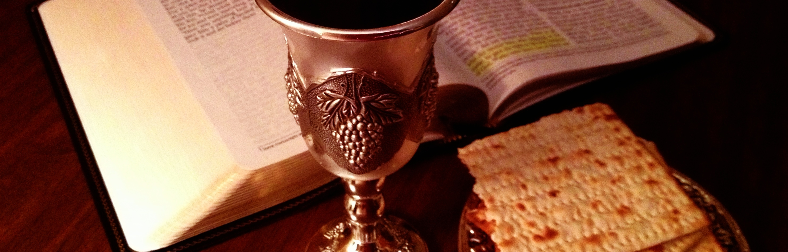
All baptized Christians are welcome to receive Communion.
All others are welcome to come forward to receive a blessing.
Currently, intinction (dipping the bread in the wine) is strictly prohibited for hygienic reason. If desired, you may instead lay your hands on the base of the chalice.

Slide 62
First Communion Hymn
#345 King of Glory, King of Peace
1. King of glory, King of peace, I will love thee;
and that love may never cease, I will move thee.
Thou hast granted my request, thou hast heard me; thou didst note my working breast,
thou hast spared me.

Slide 63
First Communion Hymn
#345 King of Glory, King of Peace
2. Wherefore with my utmost art I will sing thee, and the cream of all my heart I will bring thee. Though my sins against me cried thou didst clear me; and alone, when they replied, thou didst hear me.

Slide 64
First Communion Hymn
#345 King of Glory, King of Peace
3. Seven whole days, not one in seven,
I will praise thee;
in my heart, though not in heaven, I can raise thee.
Small it is, in this poor sort to enrol thee:
eternity's too short even to extol thee

Slide 65
Second Communion Hymn
Let Us Break Bread Together
1. Let us break bread together on our knees,
Let us break bread together on our knees.
When I fall down on my knees
with my face to the rising sun,
Oh Lord, have mercy on me.

Slide 66
Second Communion Hymn
Let Us Break Bread Together
2. Let us drink wine together on our knees,
Let us drink wine together on our knees,
When I fall down on my knees
with my face to the rising sun,
Oh Lord, have mercy on me.

Slide 67
Second Communion Hymn
Let Us Break Bread Together
3. Let us praise God together on our knees,
Let us praise God together on our knees.
When I fall down on my knees
with my face to the rising sun,
Oh Lord, have mercy on me.

Slide 68
Prayer After Communion
Celebrant Let us pray
All Eternal God, we have received a token of your promise. May we who have been nourished by holy things live as faithful heirs of your promised kingdom, in the name of Jesus Christ our Lord. Amen

Slide 69
Doxology
Celebrant Glory to God
All whose power, working in us, can do infinitely more than we can ask or imagine.
Glory to God from generation to generation, in the Church and in Christ Jesus, for ever and ever. Amen.

Slide 70
The Blessing
Celebrant Send us anywhere you would have us go, only go there with us. Place upon us any burden you desire, only stand by us to sustain us. Break any tie that binds us, except the tie that binds us to you.
And the blessing of God; the Creator, who made and knows us; the Savior, who redeems and befriends us; and the Spirit, who enlightens and sustains us, be with you this day and always. Amen.

Slide 71


Slide 72
Closing Hymn
#484 In Christ There Is No East or West
    1. In Christ there is no east or west,
    in Christ no south or north,
    but one great fellowship of love
    throughout the whole wide earth.

Slide 73
Closing Hymn
#484 In Christ There Is No East or West
    2. In Christ shall true hearts everywhere
    high communion find,
    whose service is the golden cord
    close-binding humankind

Slide 74
Closing Hymn
#484 In Christ There Is No East or West
    3. Join hands, disciples of the faith
    whate'er your race may be;
    who serves my God in truth and love
    is surely kin to me.

Slide 75
Closing Hymn
#484 In Christ There Is No East or West
    4. In Christ now meet both east and west,
    in Christ meet south and north;
    all faithful souls are joined in one
    throughout the whole wide earth.

Slide 76
Dismissal
Leader Followers of Jesus, inspired by the Holy Spirit, go, serve the world God loves.
People Thanks be to God. Alleluia!

Slide 77

Thank you for joining us today!
Please stay for refreshments after the service

Slide 78

Coming soon....
Watch your bulletins for information on Season of Creation 2026. The Spiritual Development team has a special activity planned for you in September!

